Slide 1

Octopus Deploy
Automated deployment for .NET

Slide 2
Presenter
David Rogers
.NET Developer
Web: http://davidrogers.id.au
Blog: http://davidrogers.id.au/wp

Slide 3
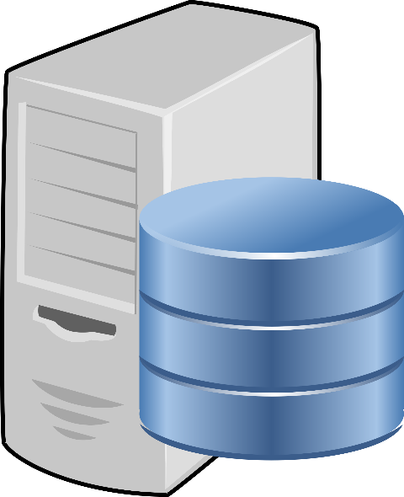
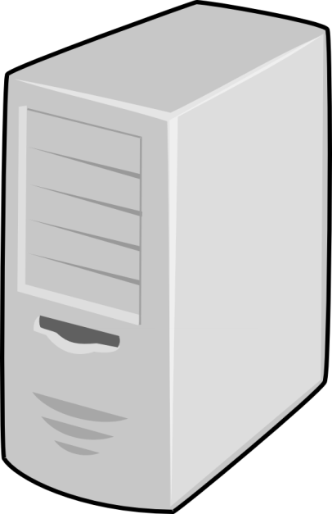
Architecture
adnugdemodb.australiasoutheast.cloudapp.azure.com
adnugdemoocto.australiasoutheast.cloudapp.azure.com
adnugdemoweb.australiasoutheast.cloudapp.azure.com

Slide 4

Why Automate Deployments?
Deploying to production is scary
Integrity
The same binaries that pass Acceptance Testing are assured to be in production
Certainty as to what code is in production
Faster
Can deploy more frequently, thus users get value more often.
Frees developer up to focus on development
Access – what happens if the deployment person disappears?

Slide 5
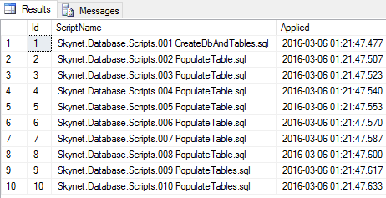
Quick Tour of the Application
GIT clone uri: https://bitbucket.org/davidrogersdev/skynet.git
Focus on the Database Application
Uses a library called DbUp - https://dbup.github.io/
Allows us to update the database with an assurance that none of the database scripts will be run more than once.
Achieves that with a table call Schema Version which tracks whether a script has been run.
Forward only (unlike EF migrations)

Slide 6
How Does It Work?
Install “tentacles” on the target machines
These are Windows Services which are compartmentalised by “instances”
Tip: always name your instances, rather than using the Default instance
Communicates using its own secure communication framework.
Trust is established between a tentacle instance and the Octopus Server via X.509 Certificates
Uses the Nuget package management format to deploy the packages
Nuget really lends itself to versioning
Create packages using a Nuget package called OctoPack

Slide 7
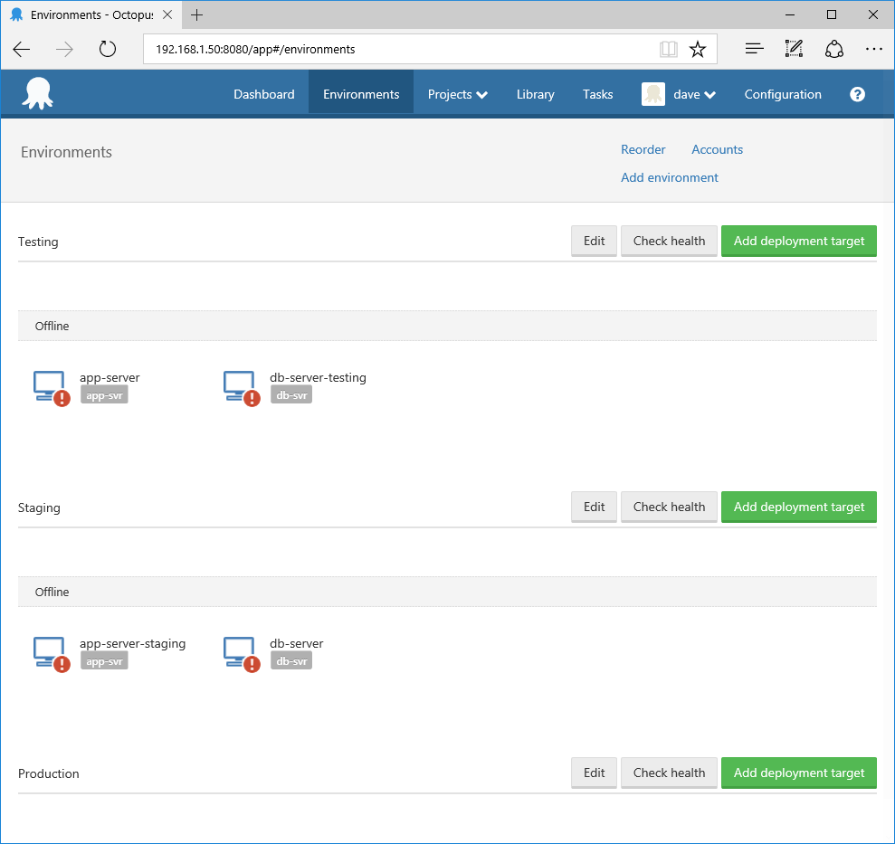
Environments
Deploy to different Environments

Slide 8
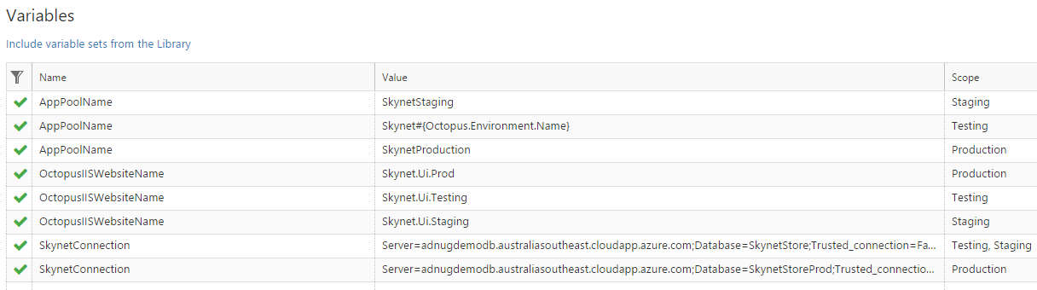
Variables
Transforms
Release
Staging
Variables
System Variables
http://docs.octopusdeploy.com/display/OD/System+variables

Slide 9
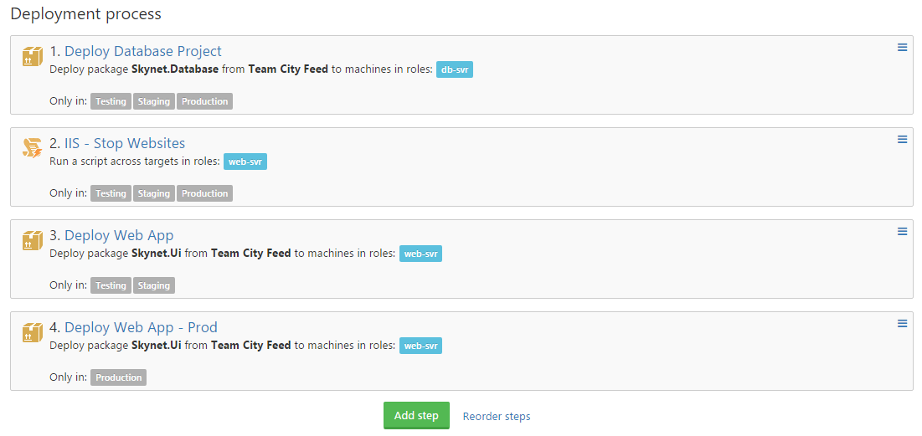
Process
Create and configure

Slide 10
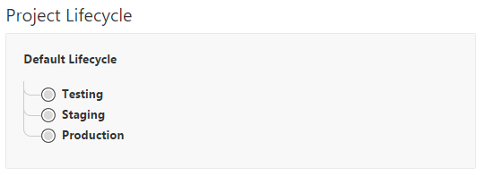
Lifecycles
This comes out of the box but you can roll your own

Slide 11
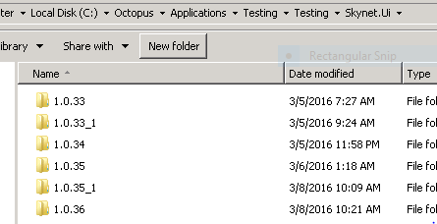
On a Tentacle
See Demo
Rollback pretty simple.
Sometimes as easy as pointing IIS to the previous site and restoring the Database backup.

Slide 12
Boils Down to These Steps
Setup
Install Octopus Server
Install Tentacles
Configure Octopus
Add Octopack to your Project
Add to your CI Build Process
Execution
Build Project and Create a Nuget Package/s
Publish the Package to a Nuget Package Feed
Kick off an Octopus Release

Slide 13
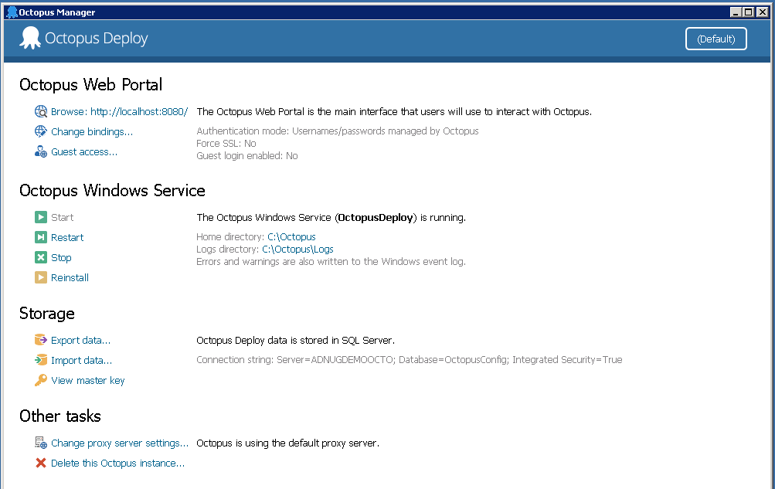
Octopus Manager

Slide 14
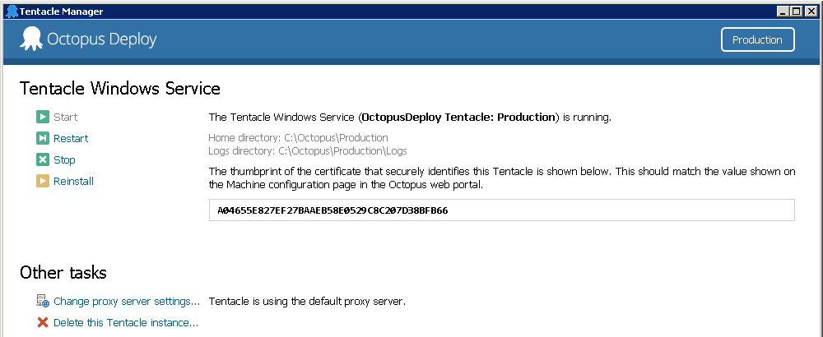
Tentacle Manager

Slide 15
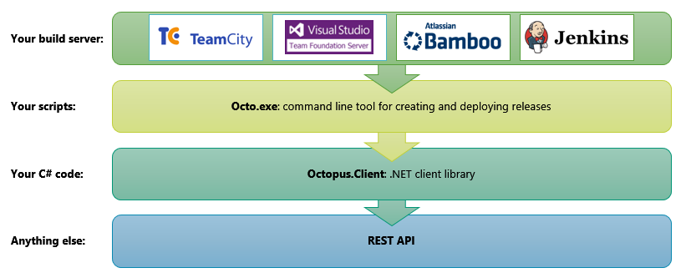
Integrations
List of integrations already:
http://docs.octopusdeploy.com/display/OD/API+and+Integration
Note: can deploy to Azure - http://docs.octopusdeploy.com/display/OD/Deploying+to+Azure

Slide 16
Community Edition
For small teams
Permits up to 5 projects
Up to 10 Target Machines (10 tentacles)
5 Users
Otherwise, there’s a 45 day trial
Not the only game in town:
https://www.visualstudio.com/en-us/features/release-management-vs.aspx

Slide 17
Doco
Lots of good stuff - http://docs.octopusdeploy.com/
Youtube - https://www.youtube.com/channel/UCURDSDCwx9ZiCMcLdc8d6Uw
Google+ - https://plus.google.com/+Octopusdeploy
Support - https://octopus.com/support

